Slide 1
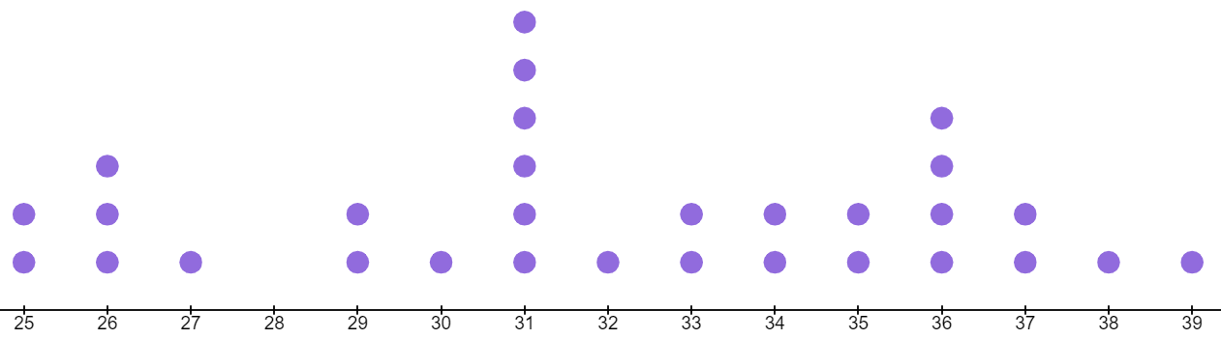
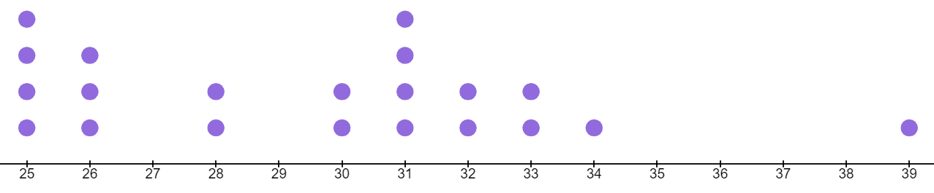

Understanding and calculating the range
Task A: What is the range?
1) For each dot plot, work out the range.
a)
20
21
22
23
24
25
26
27
28
29
30
31
32
33
34
range = 34 − 20 = 14
b)
58
59
60
61
62
63
64
65
66
67
68
69
70
71
72
range = 72 − 58 = 14
2) For each set of data, work out the range.
a) −1, 0, 1, 1, 1, 2, 4, 5, 7, 7, 8, 8, 8, 10, 10, 10, 14, 17, 17, 20
b) −7, 6, 6, −3, −9, −9, −5, 6, −1, 6, 5, −6, −8, −4, −4, −3, 4, −6, 2, 6
c) 16.2, 15.3, 1.1, 19.4, 13.7, 6.7, 4.7, 12.1, 16.3, 9.4, 8.4, 18.2, 11.9, 1.6, 17.8
range = 20 − (−1) = 21
range = 6 − (−9) = 15
range = 19.4 − 1.1 = 18.3
3)
Laura had just finished her homework on working out the range when her ink pen started to leak. What number has the ink spoiled in each case?
a) Largest number is 24 , smallest number is 14 so the range is 10
b) Largest number is 8, smallest number is -4 so the range is 12
Any number between 0 and 6
c) In order: −3, −1, −1, 0, e.g. 2 , 6, 7, 10 so the range is 13
d) Any order: 3, 5, 3, 7, 10, 12, 6, 8, e.g. 1 so the range is 11
1 or 14

Slide 2
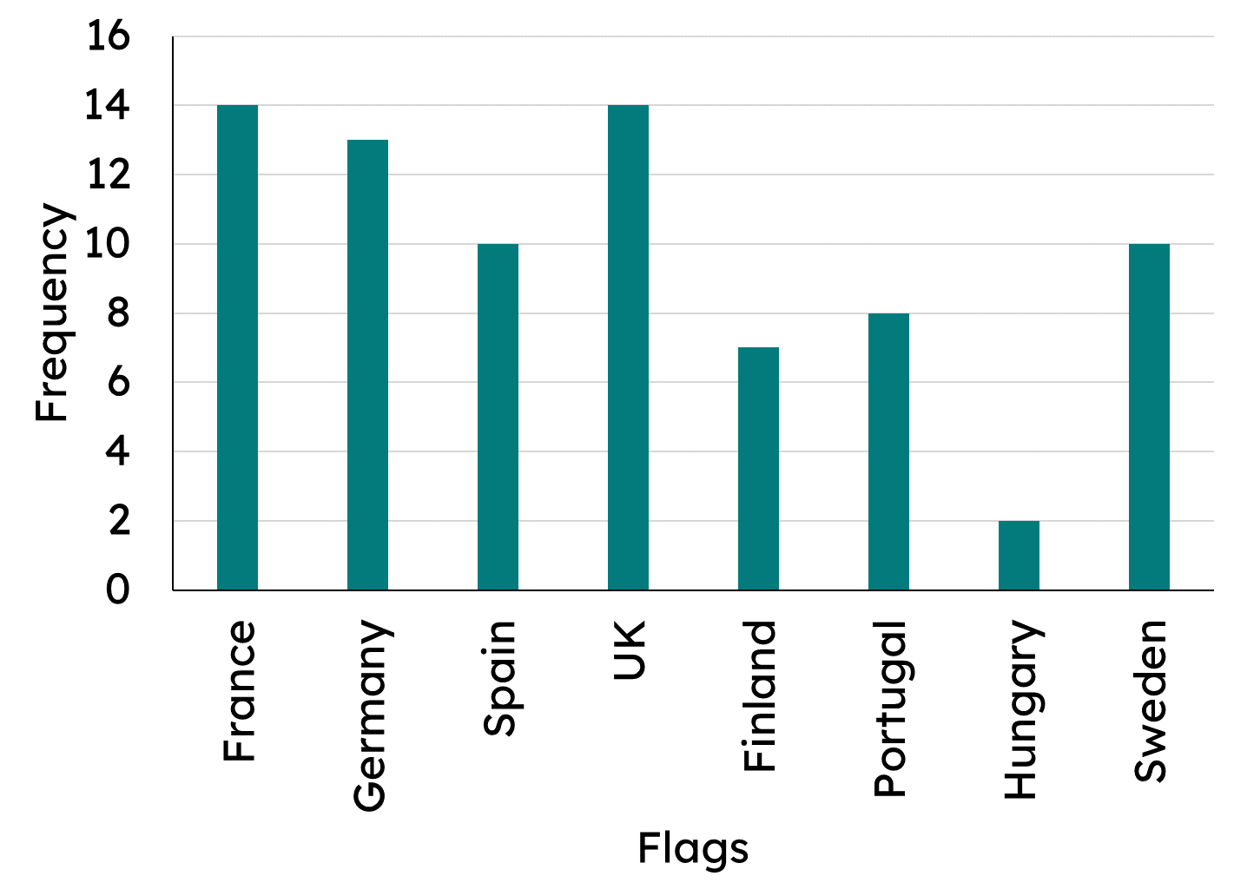
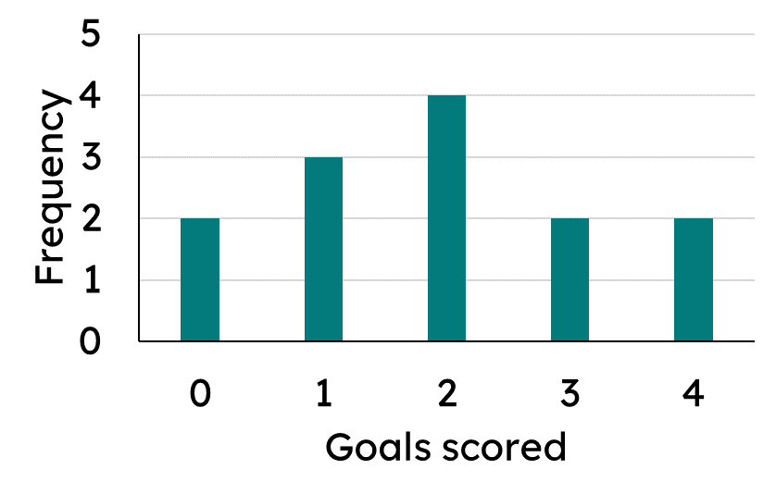


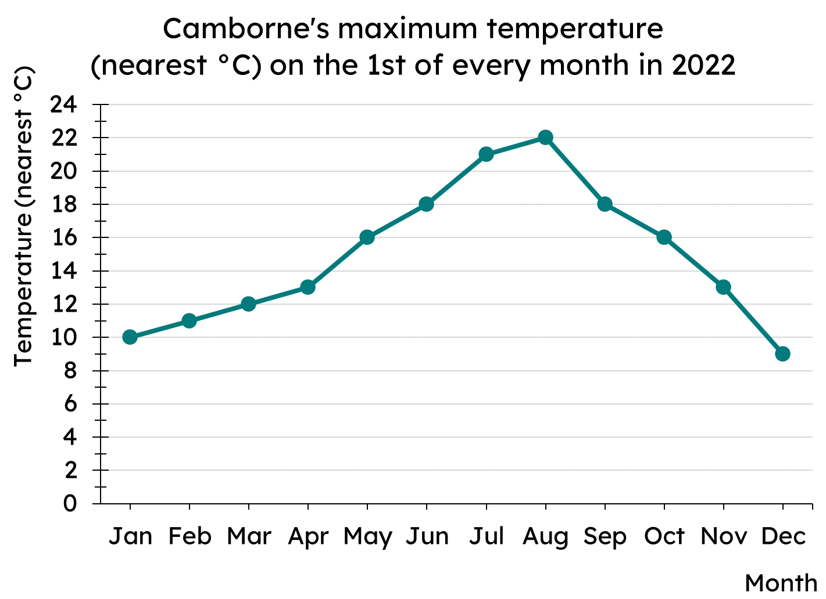
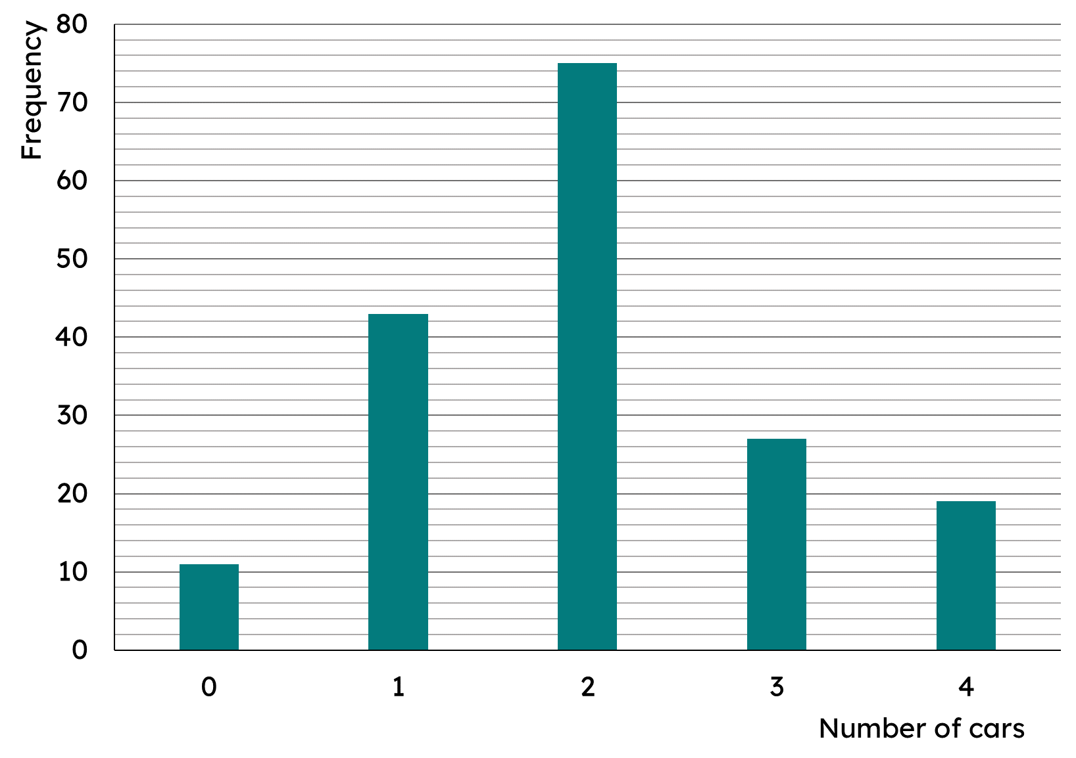
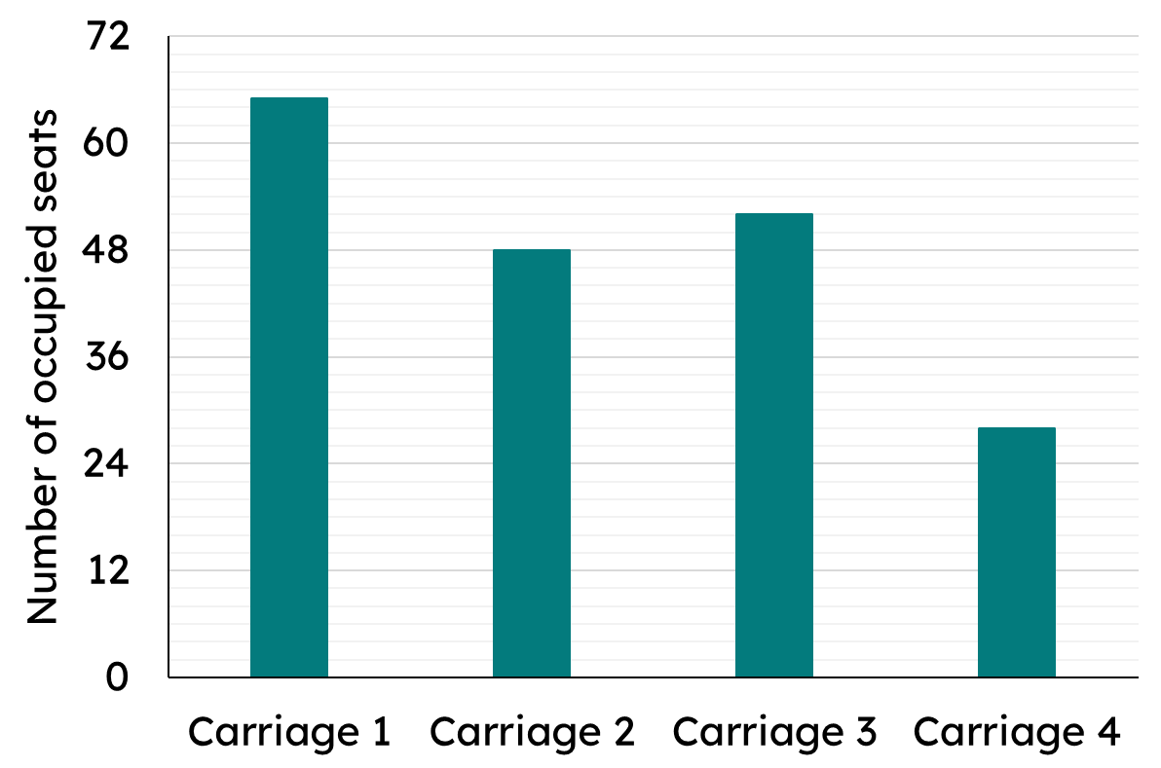
Understanding and calculating the range
Task B: Extreme values in different representations
1) Which of these representations can you find the range?
a)
b)
c)
Shoe size | 3 | 4 | 5 | 6
Frequency | 7 | 12 | 10 | 3
d)
2) For each of the following bar charts, find the range.
a)
b)
Range of cars: 4 − 0 = 4
Range of occupied seats: 65 − 28 = 37
3) Some data is represented in this frequency table about wait times at a fast food restaurant.
Wait time (mins) | 4 | 5 | 6 | 7 | 8 | 9 | 10 | 11
Frequency | 46 | 20 | 17 | 13 | 16 | 10 | 8 | 8
A local newspaper reported that customers’ wait time ranged by 38 minutes. Do you agree?
No, the range of wait times is 7 mins; from the longest wait time of 11 minutes to the shortest wait time of 4 minutes.
Mathematics in Education and Industry
v2.2

